Slide 1
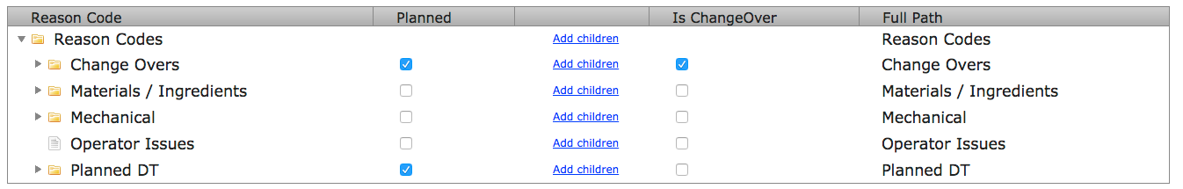
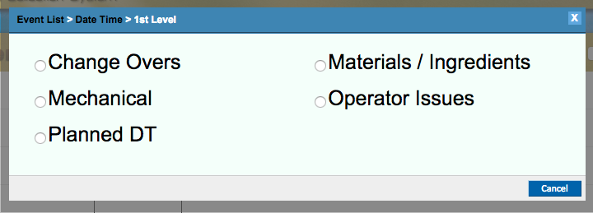
1st Layer Reason Recommendations
The system is designed to allow up to 3 layers of reason codes. You can have as many reasons as you’d like.
The 1st layer’s purpose is to show which category has the most downtime. This should be broken down by functional area, responsibility or department. Consider your ability to manage the category as a whole and the ability to create accountability.
Try to keep the number of reasons between 5-8. It allows the operator to choose a reason code at a glance
Example of Operator Interface

Slide 2
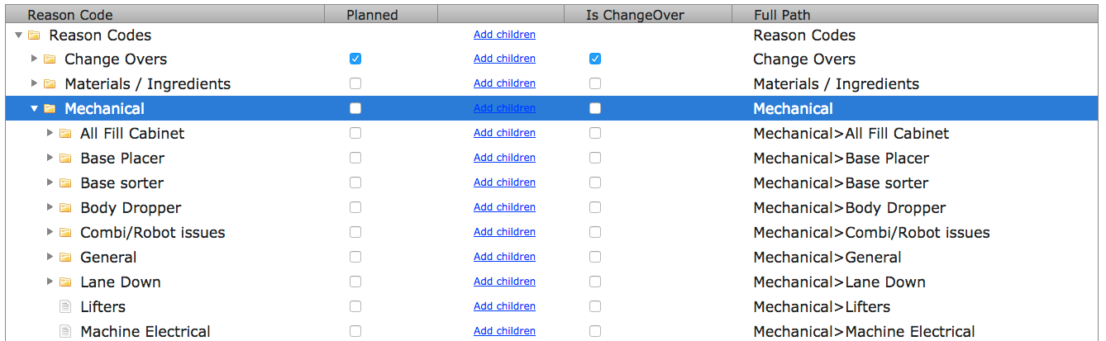
2nd Layer Reason Recommendations
The 2nd layer’s purpose is to provide a simple guide for the operator to get to the base issue in the 3rd layer. IE: The ‘Body Dropper’ process has many issues. By clicking into the folder, the issues are more specific.
3rd level reasons are not required. IE: ‘Lifters’ and ‘Machine Electrical’ are specific and do not have further explanations so they can reside in the 2nd layer. However, if ‘Lifters’ starts to receive varying comments over time, a 3rd layer within Lifters should be considered with those comments standardized as reasons.

Slide 3
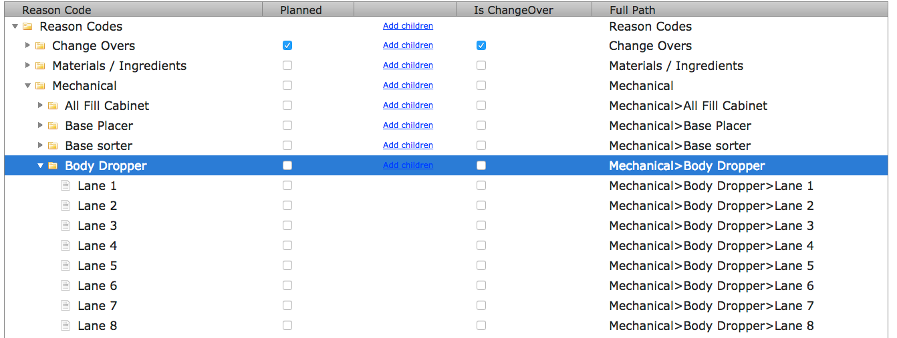
3rd Layer Reason Recommendations
The 3rd Layer’s purpose is to be the specific reason for the downtime.
Try to keep the number of reasons within each folder between 5-8 reasons. It allows the operator to choose a reason code at a glance

Slide 4
Planned Function
The planned function tells the system this is a planned event. This excludes the downtime event from the main reporting but is still tracked within the system under ‘planned downtime’.
Duration of Planned Downtime popup: This function allows you to enter in the number of minutes allowed for this reason. If the downtime event exceeds the allowable time, it splits the downtime event and leaves a downtime event behind of the difference. This is especially helpful with breaks, lunches and change overs. If there is a delay, it forces the operator to choose a reason for the delay which is the true downtime
Is ChangeOver
This function tells the system this is a change over event. It requires the operator to select a new SKU. The system then adjusts the run rate and calculates the line performance based on the new run speed.

Slide 5
Reason Code Tips
Make sure the downtime events at the last layer are actionable. Ask yourself if you can manage this issue?
Create ‘Other’ reasons in every tier and require a comment from the operators. Once every few weeks review the comments for these and look at their frequency. If they are frequent, they may warrant a new downtime code.

